Slide 1
Aggressive Periodontitis
DR.AMEENA

Slide 2
Contents:
Introduction
Historical Background
Classification
Localized Aggressive Periodontitis
Generalized Aggressive Periodontitis
Syndromes associated with aggressive periodontitis
Etiology and pathogenesis
Diagnosis

Slide 3
Therapeutic Intervention
Differences in between chronic and aggressive
Conclusion
References

Slide 4
Introduction:
Aggressive periodontitis (Early – onset periodontitis) comprises a group of rare, often severe, quickly progressive. Distinguished from chronic periodontitis - early age of clinical manifestation , rapid rate of progression, the nature and composition of the associated subgingival microflora, alterations in host immune response and familial aggregation.
Systemically healthy individuals less than 30 years old.

Slide 5
Historical background:
1923 Gottlieb – Diffuse atrophy of the alveolar bone
Loss of collagen fibers in the periodontal ligament ,Replacement by loose connective tissue ,Extensive bone resorption, ,widened PDL, gingiva - not involved.
1928 Gottlieb - hypothesized as Deep cementopathia
1938, Wannenmacher described - incisor-first molar involvement and called the disease as “Parodontitis marginalis progressiva” in young patients. He considered this disease as inflammatory process.

Slide 6
1940 Thoma and Goldman - Paradontitis - that initial abnoramality was located in the alveolar bone rather than in the cementum & consisited of vascular resorption & halisteresis rather than lacunar resorption.
1942 Orban & Weinmann introduced the term – Periodontosis.
and on the basis of one autopsy case studied in detail they described three stages in the development of disease

Slide 7
      Stage I: Desmolysis of the principal fibers of the PDL - cessation of cementum formation and resorption of alveolar bone .
      Stage II: apical migration of epithelial attachment - First signs of inflammation.
      Stage III: Development of deep infra bony periodontal pockets.
due to progressive inflammation

Slide 8
1950 - The Committee on Nomenclature of the AAP Described Periodontosis as
“A degenerative non-inflammatory destruction of the periodontium originating in one or more of the periodontal structures characterized by migration and loosening of the teeth in the presence or absence of secondary epithelial proliferation and pocket formation or secondary gingival disease.”

Slide 9
1966 - World Workshop in Periodontics
concept of periodontosis as a degenerative entity was unsubstantiated and the term should be eliminated from the nomenculature.
1967 Chaput and colleagues & Butler in 1969 introduced the term Juvenile periodontitis

Slide 10
1971 Baer defined it as “ a disease of the periodontium occurring in a otherwise healthy adolescent which is characterized by rapid bone loss of alveolar bone about more than one tooth of the permanent dentition. The amount of destruction manifested is not commensurate with the amount of local irritants”

Slide 11
1982 - Page and Schroeder
  Pre pubertal periodontitis - LOCALISED AND GENERALISED
  Juvenile periodontitis
  Rapidly progressing periodontitis
1988 - Grant, Stern, and Listgarten
  Post juvenile
  Early onset
  Juvenile – LOCALISED AND GENERALISED
  1989 - World workshop of periodontics - localized juvenile periodontitis (LJP), a subset of the broad classification of Early onset periodontitis (EOP).

Slide 12
World Workshop in 1989 - AAP classification of periodontitis.
Adult periodontitis
Early-onset periodontitis
  Pre-pubertal periodontitis - Generalized,Localized
  Juvenile periodontitis – Generalized ,Localized
  Rapidly progressive periodontitis
Periodontitis associated with systemic disease
Necrotizing ulcerative periodontitis
Refractory periodontitis

Slide 13
1999 international classification workshop - periodontitis were reclassified into three major form
1) Chronic periodontitis
2) Aggressive periodontitis
3) Necrotizing forms of periodontitis
4) Periodontal manifestation of systemic diseases

Slide 14
Mombelli et al in 2002 described 3 types of aggressive periodontitis
Secure or certain form
Loss of attachment of over 2mm in under a year
Loss of over 2mm before age of 18
Rapid bone destruction documented by radiographs
Severe bone loss before age 18

Slide 15
Uncertain or probable form
Loss of attachment of over 2mm
Severe bone destruction before age of 30 years
Insecure or possible form
Loss of attachment - unclear rate of progression - 2mm in a year
Bone destruction - unclear rate of progression

Slide 16
Features of aggressive periodontitis
Aggressive forms of periodontal disease have been defined based on the following primary features (Lang et al. 1999):
  Non-contributory medical history
  Rapid attachment loss and bone destruction
  Familial aggregation of cases

Slide 17
Secondary features :
  Amounts of microbial deposits inconsistent with severity of periodontal destruction.
  Elevated levels of A a and in some Far East populations, P g.
  Phagocyte abnormalities.
  Hyper-responsive macrophage phenotype, including PGE₂ and IL-l β in response to bacterial endotoxins.
  Progression of attachment loss and bone loss may be self-arresting.

Slide 18
Aggressive Periodontitis
Localised
Generalised

Slide 19
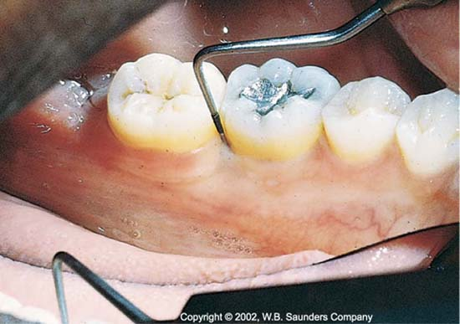
Localised aggressive periodontitis
Circumpubertal onset.
Robust serum antibody response to infecting agents.
Localized first molar/incisor presentation with interproximal attachment loss on at least two permanent teeth, one of which is a first molar, and involving no more than two teeth other than first molars and incisors
Lack of clinical inflammation
Presence of deep periodontal pockets

Slide 20
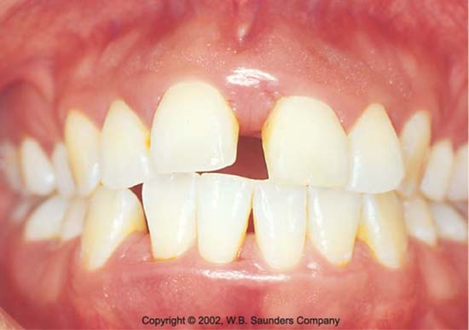
Disto labial migration, diastema formation
and Increasing mobility of the first molars.
Amount of plaque inconsistent with the amount of periodontal destruction.
Plaque that is present forms a thin biofilm on the teeth and rarely mineralizes to form calculus.

Slide 21
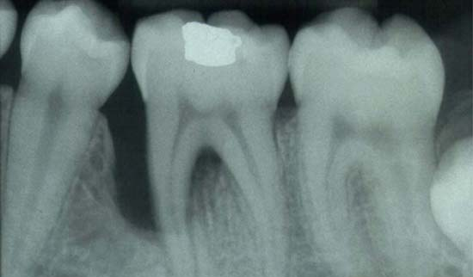
Radiographic features:
Classic diagnostic sign of localized aggressive periodontitis –
  Vertical loss of alveolar bone
  First molars and incisors
  Arc shaped loss of alveolar bone.
Rate of bone loss is about 3-4 times faster than in chronic periodontitis.

Slide 22
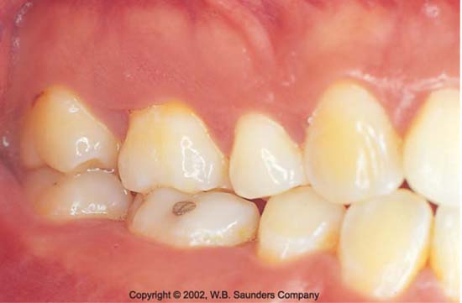
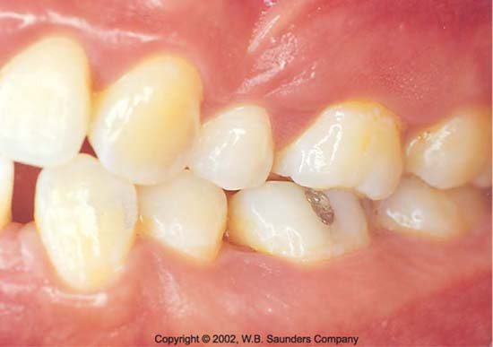
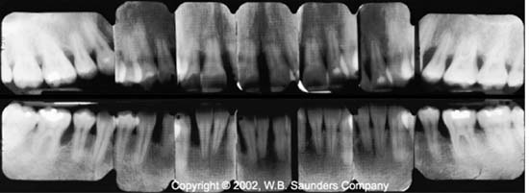
Clinical appearance of 15yr female patient with localised aggressive periodontitis
Radiographic appearance:

Slide 23
Epidemiology:
YEAR | AUTHOR | POPULATION | FINDINGS
1980 | SAXEN .L | Radiographic study in 16 yr old Finland | 0.1 % rate of prevalence
1986 | KRONAUER.E, LANG NP | Radiographic study in 16 yr old Switzerland | 0.1% rate of prevalence
1987 | SAXBY MS | Clinical & radio Study 15-19 yrs old 7266 English adolescents | 0.1% prevalence
1991 | LOE.H, BROWN | In U.S national survey 14-17 yrs Old adolescents | 0.53 % prevalence of LAP

Slide 24
YEAR | AUTHOR | POPULATION | FINDINGS
1991 | MELVIN WL SANDIFER JB GRAY JL | Predilection in males / females | Blacks at higher risk. 2.9 times more in black males than females. However more in white females than white males
2014 | SUSIN.C, ALBANDER AN | Prevalence of LAP in Asian population | 1.2 % in Baghdad and Iran population. 0.47 % in Japanese population
2014 | SUSIN et al | Prevalence of LAP in caucasians | 0.1% in north & central Europe 0.5% in south Europe 0.1-0.2 % in North America
2013 -Prasanth, Jayakumar et al - Prevalence in 9600
Subjects in Vikarabad, India - 0.16% prevalence

Slide 25
Localized distribution of lesions in LAP:
Slots and Lang et al - After initial colonization - first permanent teeth to erupt (the first molars and incisors) - A.a evades the host defense by:
  Production of PMN chemotaxis-inhibiting factors,
  Endotoxin, Collagenases, Leukotoxin, and other factors that allow the bacteria to colonize the pocket and initiate the destruction of the periodontal tissues.
  Initial attack – immune defenses – phagocytosis – neutralize leukotoxic activity - colonization of other sites prevented

Slide 26
Hillmann and Socransky et al - Bacteria antagonistic to A. a may colonize the periodontal tissues.
Slots et al - A. a may lose its leukotoxin producing ability for unknown reasons.
Page et al - Defect in cementum formation is responsible for localization of lesions.

Slide 27
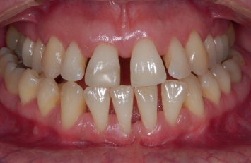
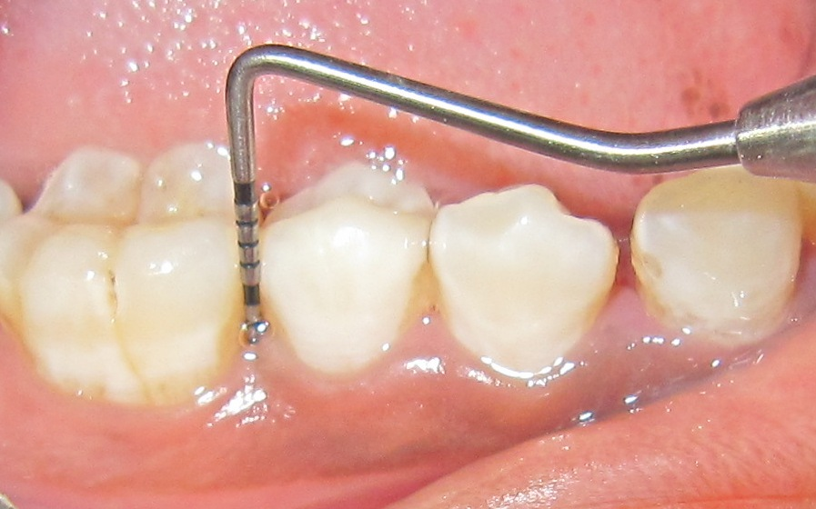
Generalized aggressive periodontitis (GAP)
Usually affecting persons under
30 years of age, but patients may be
older.
Poor serum antibody response
to infecting agents.
Generalized inter proximal attachment
loss affecting at least three permanent
teeth
Pronounced episodic nature of the
destruction

Slide 28
Clinical features:
Generalized inter proximal attachment loss affecting at least
three permanent teeth other than first molars and incisors in individuals less than age 30 but may be older
Minimal plaque inconsistent with destruction and presence of bacteria like P.gingivalis, A.actinomycetemcomitans & T.forsythia

Slide 29
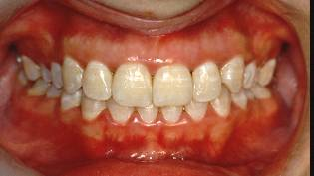
Two gingival tissue responses:
1) Severe, acutely inflamed tissue - proliferating, ulcerated, and fiery red characterized by Bleeding & Suppuration ,destructive
  stage, in which attachment and bone are actively lost.
2) Tissues may appear pink, free of inflammation, and occasionally with some degree of stippling,
  Yet deep pockets can be demonstrated by probing.
  According to Page and Schroeder this tissue response coincide with periods of quiescence in which the bone level remains stationary.

Slide 30
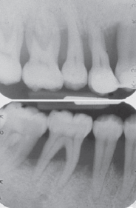
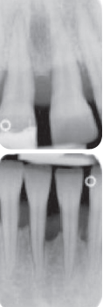
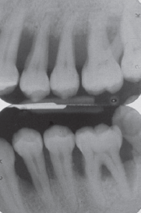
Radiographic features:
Page and co-workers described sites in generalized aggressive periodontitis (formerly RPP) patients that demonstrated osseous destruction of 25% to 60% during a 9-week period.
Radiographs of 28 yr female - GAP

Slide 31
Epidemiology:
Albandar et al 2002 - 2.3% - Uganda
Levin et al 2006 – 1.6% - Israel
Susin et al – global prevalence is 0 – 13 %
blacks at higher risk than whites.
males are at higher risk than females

Slide 32
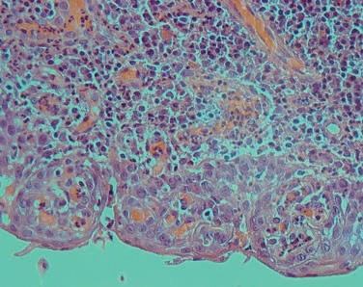
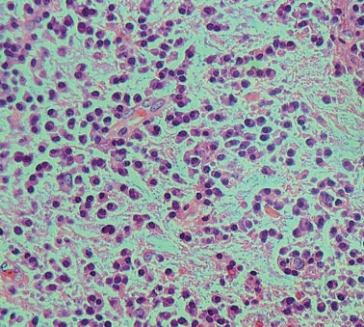
Stambolieva & Bourkova - histological examination - increased numbers of acid phosphatase - positive macrophages
Predominantly plasma cells was observed
Histopathology
Plasma cell lesion with sub-epithelial polymorphonuclear neutrophils of AgP
An abundance of plasma cells in gingival connective tissue

Slide 33
Author | Subjects | Age (years) | Classification criteria | Principal findings
Liljenberg & Lindhe 1980 | 8 LJP 7 Post-JP generalized 7 adult periodontitis | 14–18 23–29 32–56 | Baer 1971 | 70% of infiltrated connective tissue was plasma cells in JP pre-treatment biopsies, 50% in post-JP and 30% in AP. Minimal calculus in JP patients.
Syrjanen et al1984 | 9 JP or post-JP 10 relatives 19 controls | 25 ± 11 28 ± 13 Matched | Not specified | IgG plasma cells predominated over IgA and IgM plasma cells in all groups. Higher TH ⁄ TS ratio in JP patients and their relatives than controls.
Celenligil et al 1993 | 16 RPP | 22–33 | Page et al. 1983 | Plasma cell-dominated lesions with equal numbers of T and B cells in biopsies 1 month after the hygiene phase. CD4 + :CD8 + ratio of 1:12
Kleinfelder et al 2001 | 20 GEOP | 25–35 | Hart et al.1991 | Predominantly plasma cells in pre- treatment biopsies. Significantly reduced post treatment.

Slide 34
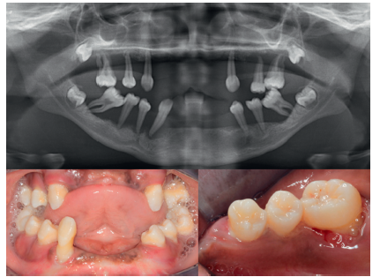
Syndromes associated with aggressive periodontitis:
Papillon – Lefevre syndrome – autosomal recessive - characterized by severe AgP, combined with palmar plantar hyperkeratosis, caused by mutations in the Cathepsin C gene.

Slide 35
Hart et al 1999 – Cathepsin C gene (CTSC) mutations causing Papillon-Lefèvre syndrome (PLS) were reported
Meade et al 2006 - Impaired killer cell cytotoxicity might contribute to the pathogenesis of PLS-associated periodontitis

Slide 36
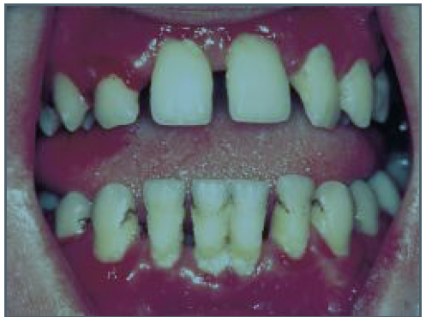
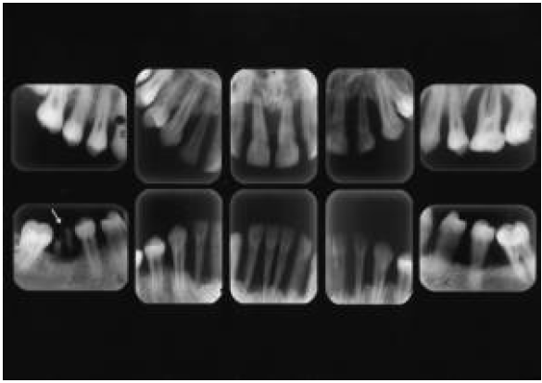
Chediak – Higashi syndrome - rare congenital disease charecterized by defective neutrophil function with abnormal lysosomal inclusions, neutropenia and reduced chemotaxis.
Occulocutaneous albinism with photophobia, neurologic features, recurrent infections and enterocolitis.

Slide 37
Down's syndrome - autosomal dominant , trisomy of chromosome 21.
Characterized by mental retardation; weak muscle tone; and typical oro facial features with epicanthic folds at the eyelids, broad bridge of the nose, underdeveloped middle part of the face in relation to an oversized mandible with a protrusive dentition, an open mouth, and a protrusive, fissured tongue.
Gingiva is red, swollen, bleed easily and is hyperplastic due to chronic mouth breathing

Slide 38
Kindlers syndrome - autosomal recessive disorder
Gingival fragility and early and rapidly progressive periodontitis were common features in this syndrome.
Other features : photosensitivity, acral hyperkeratosis, nail dystrophy, webbing and contractures of the fingers and toes, alopecia,
Actinic changes like mucosal involvement, including urethral, vaginal, anal, esophageal, and oral commissural stenosis (narrowing or constricting),eversion of the eyelids, pigmentation of the lips, and malformation of the nails.

Slide 39
Agranulocytosis
Kostman 1975 described periodontal disease in children with reduced number of neutrophils and termed as “Infantile genetic agranulocytosis” or “ congenital neutropenia”
Bauer 1946 described severe periodontitis in drug induced secondary agranulocytosis.
Ulcerations in oral cavity, oropharynx and throat is characteristic features.

Slide 40
Neutropenia
Individual with an absolute neutrophil count (ANC) of less than 1500 cells per microlitre is considered to be neutropenic.
Causes can be genetic, drug induced, any viral infections.
Cyclic neutropenia , the peripheral neutrophil number are decreased to low levels in a cycle of approximately 4 weeks.

Slide 41
Leukocyte adhesion deficiency
LAD is very rare genetic disorder. Anderson 1984
LAD results from inability to produce or express an important cell surface integrin CD 18 which is necessary for leukocytes to adhere to vessel wall at sites of infection.
Absence of neutrophils in the gingival tissues are observed.
LAD – I – CD 18
LAD – II – CD 15

Slide 42
Lazy leukocyte syndrome:
Neutropenia
Defective chemotactic response
Abnormal inflammatory response
Destruction of bone and early tooth loss

Slide 43
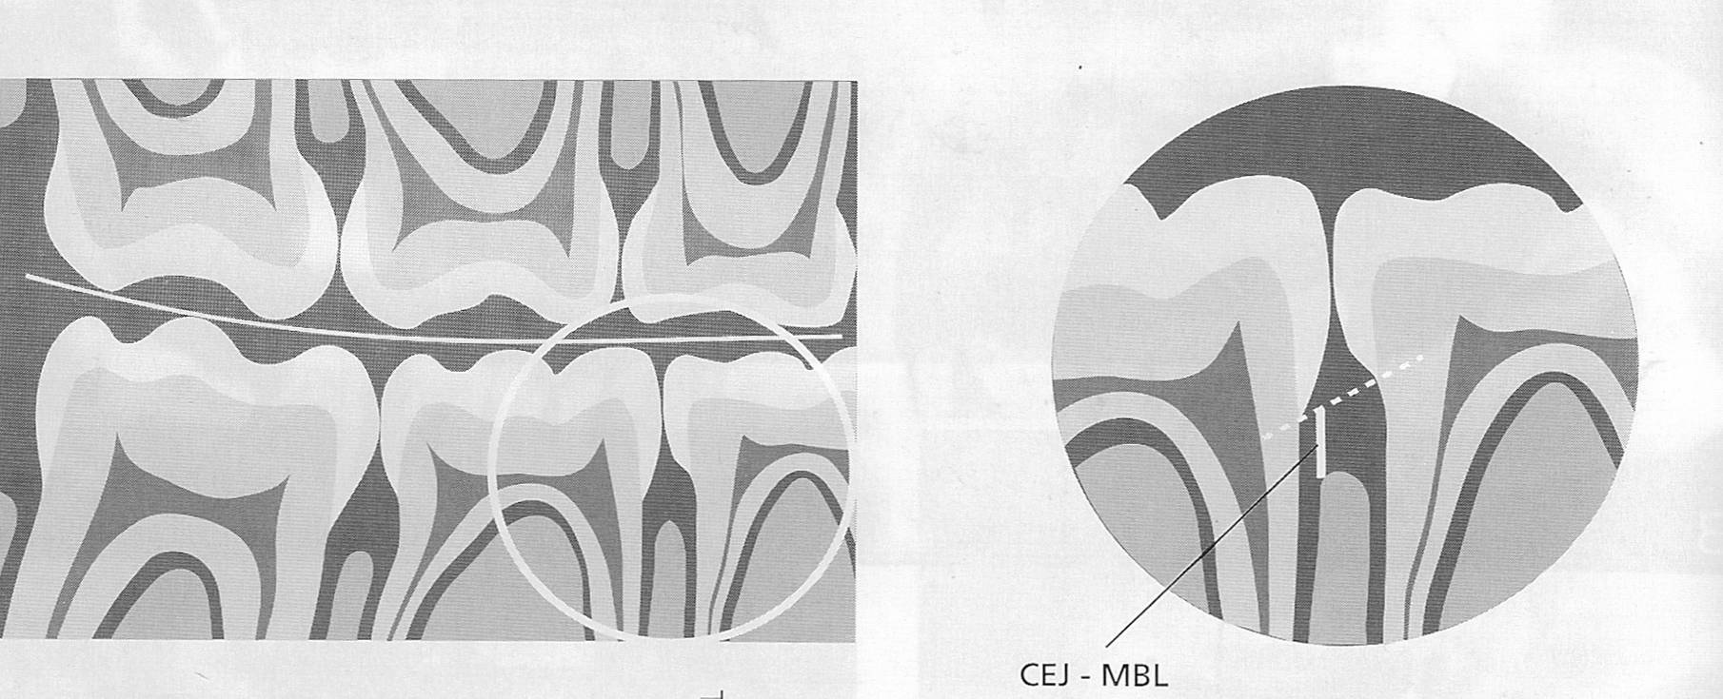
Screening:
In younger subjects – Measurement of the distance between the alveolar crest and the cemento enamel junction on bite-wing radiographs.

Slide 44
In older adolescents and adults :
  Appropriate screening - periodontal probing not radiographs.
  Screening can be stopped once evidence of attachment loss
A A P -- simplified screening examination…based on a modification of the CPITN (Ainamo et al. 1982, American Academy of Periodontology & American Dental Association 1992).
Comprehensive periodontal examination

Slide 45
Etiology and pathogenesis:
The early manifestation of clinically detectable lesions is generally interpreted as being:
The expression of highly virulent causative agents or
High levels of susceptibility of the individual patient, or
Combination of the two

Slide 46
Risk factors
Microbiologic factors
Immunologic factors
Genetic factors
Environmental factors

Slide 47
Microbiologic factors:
    Listgarten 1976, Westergaard et al. 1978: Microscopic studies and demonstrated the presence of a layer of bacterial deposits on the root surface of advanced AgP lesions.
    Newman et al. 1976,Slots 1976 ,Newman & Socransky 1977 - Gm -ve organisms comprised approximately 2/3 of the isolates and only 1/3 of the isolates in control sites.

Slide 48
The dominant microorganisms in LJP included:
  Aggregatibacter actinomycetemcomitans
  Capnocytophaga sp,
  E. corrodens,
  P. intermedia and
  Motile anaerobic rods, such as C. rectus.
  Gram-positive isolates were mostly streptococci, Actinomycetes and peptostreptococci.

Slide 49
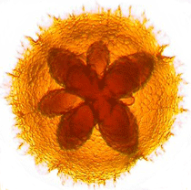
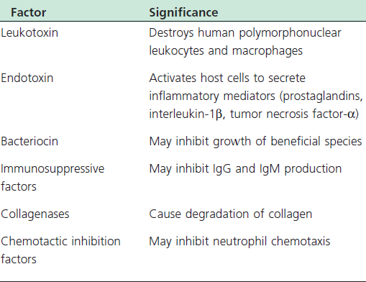
A.a is a Short, facultative anaerobic, non motile,
Gram negative rod shaped bacteria
6 Serotypes, serotype b - LAP - Asikainen et al 1991,
Zambon et al 1996

Slide 50
A.a is regarded as a key microorganism in LAP.
This link is based on the four lines of evidence: (Socransky and Haffajee 1992)& (Tonetti &Mombelli 1999)
1. A. a is found in high frequency (approximately 90%) in lesions characteristic of LAP. Elevated levels of A. a. is often observed at the disease sites - Haffajee et al. 1984,Mandell et al. 1987
2.Demonstration of virulence factors: A. a produces a number of potentially pathogenic substances, including a leukotoxin that may contribute to the disease process - Zambon et al 1988, Slots & Schonfeld 1991

Slide 51
3. Immune responses: Patients with the LAP have significantly elevated serum antibody titers to A.a. - Genco et al in 1985, Mandell et al. 1977; Sandholm et al. 1987
4. Clinical studies show a correlation between treatment outcomes & subgingival load of A. a after therapy: unsuccessful treatment outcomes - a failure in reducing subgingival laods of A.a - Slots & Rosling 1983, Haffajee et al. 1984; Preus 1988

Slide 52
Generalized aggressive periodontitis (GAP), has been associated with:
  Porphyromonas gingivalis,
  Bacteroides forsythus and
  A.a.
  Non-responding lesions often contain P. gingivalis in elevated proportions

Slide 53
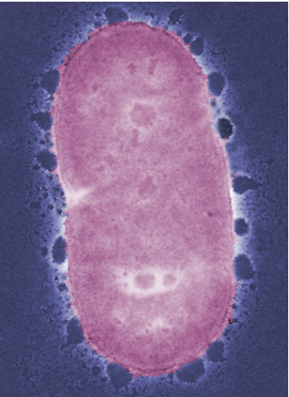
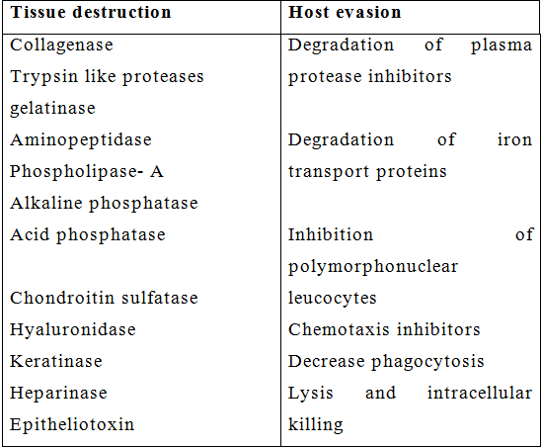
Porphyromonas gingivalis:
Gram –ve,Obligatory anaerobe,Fastidious,
Asaccharolytic,Non spore forming
Virulence factors – LPS,gingipains,fimbriae

Slide 54
Takeuchi Y et al - Treponema lecithinolyticum and Treponema Socranskii - elevated in Generalized Aggressive Periodontitis.
Schlafer S, Riep B et al -Filifactor alocis - gram positive anaerobic rod - potential of being periodontal pathogen - elevated in aggressive periodontitis patients.
Langendijk PS et al- Desulfo microbium orale, a sulfate reducing bacteria - involved in various categories of periodontitis synergistically with red complex organisms.
Yamabe et al - Methano brevibacter oralis – a putative periodontal pathogen - suggested to be involved in aggressive periodontitis

Slide 55
Bacterial damage to the periodontium
Bacteria cause destruction of the marginal periodontium via two related mechanisms:
  1.Direct action of the microorganisms or their products on the host tissues.
  A.a is able translocate across junctional epithelium and invade underlying connective tissue. - Saglie et al 1988
  2.They elicit tissue-damaging inflammatory responses.
  Williams et al 1989

Slide 56
Host response to bacterial pathogens
Local
Systemic host responses
Local inflammatory responses characterised by an intense recruitment of Polymorphonuclear leucocytes both within the tissues and periodontal pocket - local defense against bacterial aggregation.
  B cells and Antibody-producing plasma cells - Liljenberg & Lindhe,1980

Slide 57
  Predominantly IgG-producing cells,elevated IgG4 - Mackler et al. 1977, 1978, Waldrop et al. 1981, Ogawa et al. 1989.
T cells - Depressed T- helper to T- suppressor ratio - Taubman et al. 1988, 1991.
Mononuclear cells- reduced
Local inflammatory responses are characterized by:
  PGE₂,
  IL - 1α
  IL -l β in both crevicular fluid and tissue -Masada et al. 1990, Offenbacher et al. 1993.

Slide 58
  Prostaglandin E₂ – Increased compared to healthy and CGP
Califano et al 1992 - antibodies reactive with carbohydrate in AgP patients consist of IgG₂.
High titers of A.a,IgG₂ have been demonstrated in LAP patients.
GAP patients are frequently sero negative for A.a. or display low titers and avidity.
Tew et al 1996 - Anti A.a. serotype polysaccharide IgG₂, therefore, are considered to be protective against widespread AgP

Slide 59
Van Dyke et al. 1985 - PMN abnormalities – decreased migration and antibacterial functions, in LAP patients seem to cluster in families - inherited.
Neutrophil abnormalities in aggressive periodontitis include abnormality in adherence, chemotaxis, superoxide generation, phagocytosis, bactericidal activity.

Slide 60
75% of patients with LAP have dysfunctional neutrophils involving decreased expression of G-protein coupled receptors because of decrease in gp 110KDa .
This results in a decrease in the chemotactic response to chemotactic agents like C5a, N-formyl methionyl leucyl phenyl alanine and leukotriene B4.
This defect is called a global membrane receptor defect. This also causes defect in trans endothelial migration, transepithelial migration and chemotaxis

Slide 61
Buchmann et al -reported elevated neutrophil counts in aggressive Periodontitis.Approximately 75% of patients with LAP have dysfunctional neutrophils.
There is defective chemotactic response to several chemotactic agents- c5a, FMLP and leukotriene B4.

Slide 62
Patients with aggressive Periodontitis exhibited impaired neutrophil chemo taxis and this may involve faulty surface receptors for Chemotactic stimulants (PAN RECEPTOR DEFECT) - Hidalgo et al 1997
Signal transduction after Receptor-Ligand interaction is decreased.

Slide 63
Kantarci A , Van dyke TE - Hyperactive / primed neutrophil that leads to increased tissue destruction in ‘Aggressive Periodontitis’(increased neutrophil adhesion, enzyme release, and elevated oxidative burst)
Most characteristic event in neutrophil priming or hyperactivity is synthesis and release of oxidative burst products like superoxide, hydroxyl radicals & hydrogen peroxide, from both resting and stimulated cells - Kaner D, Bernimoulin JP et al

Slide 64
Nermin et al – greater β-glucuronidase and myeloperoxidase activity in patients with AgP.
Phagocytosis of A.a normal – however decreased intracellular killing of this organism probably due to defective calcium influx factor activity in neutrophils.

Slide 65
Anusaksathien and Dolby 1991 – Auto immunity- GAP - Increased expression of type II MHC molecules,HLA DR4 ,Polyclonal activation of B cells

Slide 66
Viruses in aggressive periodontitis:
Subgingival presence of HCMV and EBV-1 VIRUS are strongly associated with aggressive periodontitis.
Bilichodmath S, Mangalekar SB et al -Herpesviruses was studied in Indian patients - chronic and aggressive periodontitis - multiplex PCR, the prevalence of herpes simplex
virus type 1, Epstein–Barr virus and human cytomegalovirus
proved to be more frequent in patients with chronic periodontitis than in aggressive periodontitis.

Slide 67
VIRUSES | CHRONIC PERIODONTITIS | AGGRESSIVE PERIODNTITIS
HSV-1 | 19 ( 100%) | 08 (57.14%)
HSV-2 | 03 (15.7%) | NIL
EBV | 15 (78.9%) | 04 (28.57%)
HCMV | 05(26.31%) | 01(7.14%)

Slide 68
Aggressive Periodontitis
B.Shalini
III MDS

Slide 69
Contents:
Introduction
Historical Background
Classification
Localized Aggressive Periodontitis
Generalized Aggressive Periodontitis
Syndromes associated with aggressive periodontitis
Etiology and pathogenesis
Diagnosis

Slide 70
Therapeutic Intervention
Differences in between chronic and aggressive
Conclusion
References

Slide 71
Immunological response:
Innate and inﬂammatory host immune responses to the gingival bioﬁlm
Adaptive - cell mediated or humoral

Slide 72
Innate immunity
Primary function is to ﬁght invading pathogens such as bacteria, fungi, viruses, and other microorganisms in order to protect and maintain immune homeostasis.
The innate immune system provides the most immediate, and often a completely sufﬁcient, response when cells encounter pathogens.

Slide 73
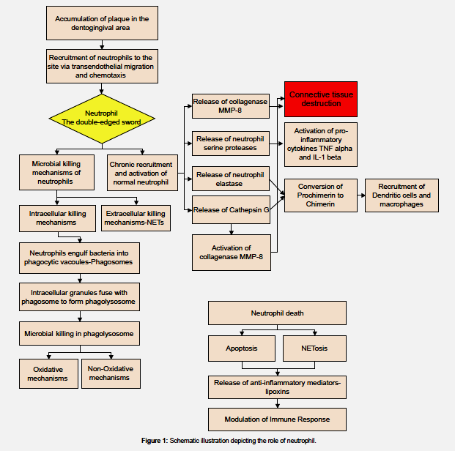
Neutrophils:
sc

Slide 74
Pathogen-recognition receptors - identiﬁed and characterized, including toll-like receptors, Nod-like receptors, RIG-like receptors and dectins as pathogen sensors.
Toll-like receptors -most studied pattern-recognition receptors -role in detecting varied pathogen-associated molecular patterns.
TLR4 -lipopolysaccharide of gram negative bacteria
TLR2 forms heterodimers with TLR 1 or TLR6 and recognizes peptidoglycan, lipopeptide and lipoproteins.

Slide 75
Once these receptors - co-receptors or adaptor molecules, recognize pathogen-related biomolecules
several intracellular signaling events occur
leading to the production of inﬂammatory cytokines, antimicrobial peptides, costimulatory molecules, type I interferons and chemokines to mount the innate immune response

Slide 76
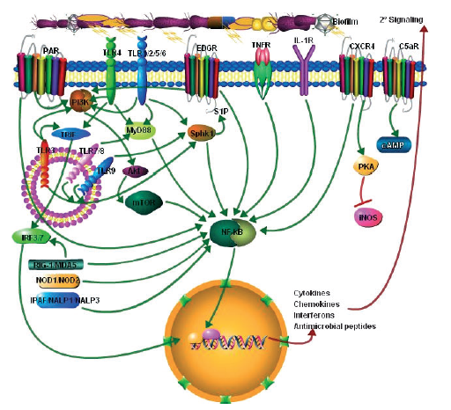

Slide 77
Adaptive immunity:
T cells
B cells
T-cells behave as a double-edged sword - The release of excessive amounts of cytokines from T cells will result in damage to the host because of their tissue-degradative properties.
T- cells recognize antigens – T-cell antigen receptor – in association with MHC – I , II
MHC- Locus on chromosome 6 involved in antigen uptake,presentation and processing.

Slide 78
MHC – I – intracellular antigens to CD8
MHC – II – extracellular antigens to CD4
T-helper cells - regulate immune response
T-helper 1 cells – act on intracellular bacteria - triggered by IL-2,IL-12, TNFα and interferon gamma
T-helper 2 cells –extracellular - IL-4,5,6,10,13
T-helper 17 cells – IL 17,TGFβ

Slide 79
T-helper 2 cells are more abundant than T-helper 1 cells in periodontal-disease sites - Albandar JM, Gemmell E, Lappin DF.
Reduced interleukin-12 permit the Th2 responses lead to the activation of B cells destructive lesion enhanced IgG,B-cell–derived interleukin-1β.
IgG Antibody response to A.a elevated.
IgG 2 level in GCF exceeds serum by 20 fold - Ling et al

Slide 80
Human leukocyte antigens
MHC- (Major Histocompatability Complex ) Locus on chromosome 6 involved in antigen uptake, presentation and processing.
MHC – I, II
HLA-A 9, HLA-A23, HLA-A24 , HLA-A 28, HLA-A 33, and
HLA-B 15, HLA-DR4 increased in patients with AgP
Risk of AgP in HLA-A9 and B-15 positive individuals is
1.5 to 3.5 times than those lacking these antigens.
Negative correlation between HLA-A2 and HLA-A12 and localized aggressive Periodontitis.

Slide 81
Role of auto immunity
Anusaksathein and Dolby (1991)
Auto immunity has been considered to have a role In Generalized aggressive Periodontitis
They found host antibodies to collagen, DNA and IgG.

Slide 82
Genetic aspects
Saxen & Nevanlinna 1984, Beaty et al. 1987, Long et al. 1987, Boughman et al. 1992, Marazita et al. 1994 -Prevalence of AgP is disproportionately high among certain families, where the percentage of affected siblings may reach 40-50%.
Pattern of disease transmission - mendelian inheritence of gene
Saxen & Nevanlinna 1984 et al - Seggregation analyses
  (Information about the mode of inheritance of a genetic trait ) - autosomal dominant mode of inheritance

Slide 83
Boughman et al. 1986 - Linkage of LAP - vitamin D binding locus on region q of chromosome 4 in a large family of the Brandywine population
Hart et al 1993 - Different results in different populations
Scapoli et al 2006 -evidence of linkage with COX-2 gene IL- 1 gene complex
Gunsolley et al 1988 - high titers of specific antibodies is race-dependent and probably protective,under genetic control as a co-dominant trait, independent of the risk for AgP.

Slide 84
Modifying disease genes in relation to periodontitis
Interleukin-1 gene
TNF-α gene , TGF-β
Fc receptor gene
N-formyl peptide receptor
Vitamin D receptor
HLA genes
N-acetyltransferase

Slide 85
Cytokines:
IL – 1β – Diehl et al – AgP
IL-4 - Gonzales JR – GAP – caucasian population
IL-6 -Nibali L et al - Genetic polymorphisms in the IL-6 gene may have an impact in aetiopathogenesis.
IL-13 - Wu YM – AgP
IL-17 – Jain N et al – Agp
IL-2,8,10,18,23 - NOT Significant in Agp

Slide 86
TNF-α GENE POLYMORPHISMS
TNF- α gene - located on chromosome 6 within the major histocompatibility complex. The genetic polymorphisms are mainly G to A transitions.
Craandijk et al 2002- R-alleles were found at position –376,-308,-238 and +489

Slide 87
FCγR GENE POLYMORPHISMS:
The receptors for the constant region (Fc) of IgG are termed FcγR, genes for FcγR - the long arm of chromosome 1 and encode for three main classes FcγRI, II, III
neutrophil specific receptor – phagocytosis of IgG opsonised bacteria
Dimou et al 2010 – systematic review – FcγRIII – AgP

Slide 88
N-FORMYL PEPTIDE RECEPTOR
The bacteria derived N-formyl-methionyl peptides – affinity to the N-formyl-methionyl peptide cell receptor - after binding to the neutrophil receptor - neutrophils – activated - migrate to the site of infection. FPR gene
n-formyl-l-leucyl-l-phenylalanine peptides - structural analogs of bacterial products - chemotaxis of neutrophils to areas of bacterial infection.
The alterations resulted in amino acid changes in a region of the fMLP receptor involved in ligand binding and signal transduction.

Slide 89
VITAMIN D RECEPTOR GENE:
Hennig et al - association of a vitamin D receptor gene polymorphisms with localised AP
VDR Taq 1 gene - LAP
  HUMAN LEUKOCYTE ANTIGEN POLYMORPHISM:
antigens for tissue adaptation , class I and class II
HLA A9, A24, B15, DR4 Polymorphism result in increased T cell response against Pg LPS and thus increased susceptibility to early onset periodontitis.

Slide 90
Pattern recognition receptor genes:
Are an array of proteins expressed by cells of the innate immune system - associated with pathogen molecules - contribute to the rapid host response to microbial pathogens.
TLR : TLR4 – Chrzeszczyk 2015 - AgP

Slide 91
Environmental factors:
Schenkein et al. 1995: cigarette smoking was shown to be a risk factor
Smokers with GAP had more affected teeth and greater mean levels of attachment loss
IgG2 serum levels as well as antibody levels against A.a. are significantly depressed in subjects with GAP who smoked.

Slide 92
Current concept
Aggressive forms of periodontitis are currently considered to be multifactorial diseases
Inheritance of AgP susceptibility is probably insufficient for the development of disease.
Environmental exposure to potential pathogens endowed with specific virulence factors is also a necessary step.
Host inability to effectively deal with the bacterial aggression and to avoid inflammatory tissue damage results in initiation of the disease process

Slide 93
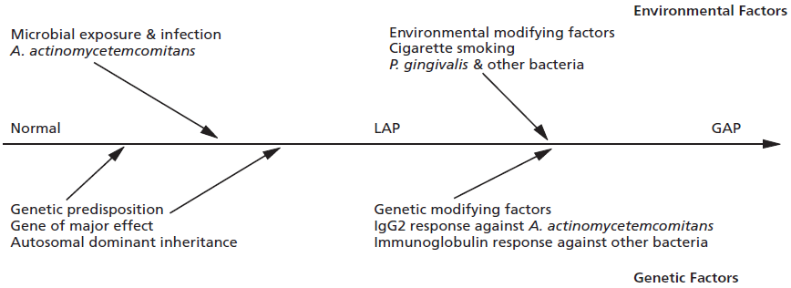

Slide 94
Diagnosis:
1.Clinical
2.Microbiological
3.Evaluation of host defences
4.Genetic diagnosis

Slide 95
Clinical diagnosis
Based on
  Specific medical and dental history
  Clinical examination of the periodontium.
  Supplementation with other, more advanced aids to properly diagnose, treatment plan and monitor these diseases.
AgP is diagnosed - primary & secondary features described
Based on the both clinical and laboratory aspects.

Slide 96
Tentative diagnosis is based on:
  No systemic involvement
  Rapid attachment loss
  Familial aggregation
  Less amount of local factors when compared to the amount of destruction

Slide 97
Microbiological diagnosis
Presence of A.a and P.g
A.a and P.g – transmitted to other family members
Microbial testing of spouses and other family members
Useful for - initial diagnosis
establish a differential diagnosis
re-evaluation and recall phase
at different stages of the treatment plan

Slide 98
Culture Methods
Only current method capable of determining the in vitro antimicrobial susceptibility of periodontal pathogens.
Provide a quantitative measurement of all major viable microorganisms in the specimen.
Eg : Malachite green bacitracin agar
TSBV agar is an excellent medium for A.a.

Slide 99
Immunodiagnostic Methods
Bonta et al (1985) described an indirect immunoflourescence identification method of A.a. with a detection limit of 500 cells/ml, a sensitivity of 82 - 100% and a specificity of 88-92% compared with selective & nonselective culture.
Bacterial concentration fluroscene immunoassay.
Evalusite test
Nucleic acid probes
Polymerase chain reaction

Slide 100
Evaluation of host defenses
AgP - associated with impairment of host defenses.
Recent investigations have indicated specific pattern of host responses to bacterial pathogens are associated with different forms of periodontitis .
This early evidence may be extremely helpful in development of clinically useful tests to estimate the risk of developing AgP.

Slide 101
In GAP decreased ability to mount high titers of specific IgG2 antibodies to A.a,GCF – PGE2
Serum antibody titers ( IgG₂ ) &/or Avidity to A.a - Useful in D/d of GAP & LAP syndromes.

Slide 102
Therapeutic Intervention
Treatment Approach in the Past
Extraction of involved teeth. Transplantation of developing third molars.
Occlusal reduction
Standard periodontal therapies.
Antibiotic therapy: As an adjunct to standard therapy.
Genco ( 1981) - LAgP – SRP + tetracycline 250 mg 4 times daily for 2 weeks , modified Widmans flap and periodic recall visits (one visit every month for 6 months)

Slide 103
Current Therapeutic approach
Successful treatment dependent on:
  Early diagnosis,
  Directing therapy towards elimination or suppression of the infecting microorganisms and
  Providing an environment conducive to long-term maintenance.

Slide 104
Therapeutic modalities:
Non Surgical therapy
Antimicrobial therapy
Regenerative therapy
Full mouth disinfection
Treatment planning and restorative considerations
Use of dental implants
Periodontal maintenance

Slide 105
Non surgical therapy:
Slots and Rosling – SRP – 0.3mm – 16weeks
Gunsolley et al – SRP – LAP- 4YRS – PD 19.4% - PD 2.8%
Hughes et al – SRP – BOP reduced by 34%
Kamma JJ et al - Laser irradiation of pockets along with SRP showed superior results than SRP alone in AP Patients
Oliveria et al - PDT is a novel photochemical approach in management of AP.
Deas & Mealey et al - Non surgical therapy reduced A.a, Capnocytophaga and Spirochetes but not completely eliminated them.

Slide 106
Antimicrobial therapy:
Slots and Rosling , Kornman and Robertson used tetracycline regimen and showed improvement in clinical and microbiological assessments
25 % of patients treated with this regimen showed continous disease progression.
Saxen and Asikainen , Vonwinkelhoff (1989) proposed the combination of AMOXICILLIN AND METRONIDAZOLE

Slide 107
The choice of antibiotics can be either empiric or guided by information about the nature of involved pathogenic organism and their antibiotic susceptibility profile.
Herrara et al – Systematic review – SRP + ANTIMICROBIALS – good results
Haffajee et al (2003) conducted an meta analysis and stated that greater clinical improvements following systemic antibiotic administration upon completion of subgingival instrumentation.

Slide 108
Meta-analysis – Sgolastra et al – amoxicillin+metronidazole + SRP – better results – CAL gain and PD reduction
Systemic tetracycline (250 mg of tetracycline hydrochloride four times daily for at least 1 week) should be given in conjunction with local mechanical therapy. If surgery is indicated, systemic tetracycline should be prescribed and the patient instructed to begin taking the antibiotic approximately 1 hour before surgery.

Slide 109
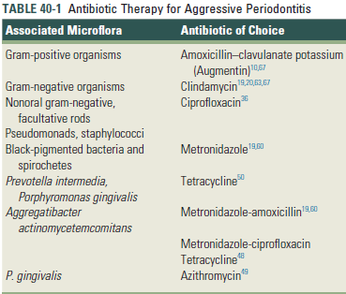

Slide 110
Recently prescribed dosages

Slide 111
Adjunctive administration of antibiotics:
  Tetracyclines (250 mg qid X 14 days) Slots et al
  Doxycycline (100 mg bid X 7 days)Bornhart et al
  Metronidazole (250 mg tid X 7 days) Loesche et al
  Metronidazole + amoxicillin(250 mg MNZ + 375 g AXL) van Winkelhoff et al

Slide 112
Antibiotics have been used in essentially 2 ways for treatment of AgP:
1.In combination with intensive instrumentation over a short period of time after achievement of adequate plaque control in a pretreatment motivation period.
2. As a staged approach after completion of initial therapy.

Slide 113
Local delivery:
Sakellari et al – local antimicrobial vs SRP in GAP – 40% TETRACYCLINE GEL.
Purucker et al – compared the effect of tetracycline fibres with systemic amoxicillin/clavulanic acid – 52 weeks – no significance.
Kaner et al – compared chlorhexidine chip with systemic amoxicillin + metronidazole, CHX group – improved.

Slide 114
Access flap surgery
A.a. is difficult to eliminate by conventional mechanical therapy.
Slots & Rosling 1983, Christersson et al. 1985, Kornman & Robertson 1985:
  SRP in LP lesions could not suppress A.a. below detection levels.
Christersson et al. 1985:
  Soft tissue curettage and access flap therapy also had limited success in eliminating A.a.

Slide 115
Regenerative:
Bone grafting:
Yukna & Sepe – FDBA – 80% DEFECT FILL
Marby et al – FDBA – 72.7 % DEFECT FILL in LAP
Evans et al. - evaluated a 4:1 (volume by volume) ratio combination of beta-tricalcium phosphate/tetracycline, hydroxyapatite/tetracycline or freeze-dried bone allograft/tetracycline in patients with localized aggressive periodontitis.

Slide 116
Guided tissue regeneration:
Sirirat et al - compared the effect of a polytetraﬂuoroethylene membrane with osseous surgery in six patients with aggressive periodontitis.
Zucchelli et al - localized aggressive periodontits and chronic periodontitis using titanium reinforced polytetraﬂuoroethylene membranes.
DiBattista et al - polytetraﬂuoroethylene membranes and calcium-sulfate, FDBA and doxycycline.
Mengel et al - three-wall bony defects - bioactive glass

Slide 117
Biological mediators:
EMP’s – Vandana et al
Growth factors
PRP,PRF

Slide 118
Full mouth disinfection:
Quirynen et al - consists of full-mouth debridement (removal of all plaque and calculus) completed in two appointments within a 24-hour period.
In addition to scaling and root planing, the tongue is brushed with a chlorhexidine gel (1%) for 1 minute, the mouth is rinsed with a chlorhexidine solution (0.2%) for 2 minutes, and periodontal pockets are irrigated with a chlorhexidine solution (1%).

Slide 119
De Soete et al - found a significant reduction in probing pocket depth and gain in clinical attachment in patients with aggressive periodontitis up to 8 months after treatment compared with controls (scaling and root planing by quadrant at 2-week intervals).

Slide 120
Current concepts:
Non surgical
Tetracycline fibres CHX chip
Photodynamic therapy :
Moreira et al 2015 – SRP+PDT (Phenothiazine) – diode laser – 670nm,75mW.
Chitsazi et al 2014 – SRP+PDT (Toluidine blue) – diode laser,670nm,75 Mw.
Chatzopoulos 2015 et al- PDT with repeated visits = SRP + antimicrobials

Slide 121
Antimicrobials:
Ardila CM et al 2015 – Systemic moxifloxacin in GAP
Gurgan C et al 2015 – Systemic Moxifloxacin and Amox + Metronidazole – Moxifloxacin showed better results.
Lourenco T 2015 – AMOX + Metronidazole with full mouth disinfection

Slide 122
Surgical :
Bone grafts – FDBA beta tri calcium phosphate + hydroxyapatite
GTR – PTFE Bioresorbable + Bioactive glass
Biological mediators : EMPs

Slide 123
Host modulation:
Another approach for treating aggressive periodontitis is through modulation of host response by sub antimicrobial or NSAIDs in conjunction with conventional therapy
The use of low dose doxycycline may aid in preventing
the destruction of periodontal attachment apparatus

Slide 124
Occlusal adjustment in case of tooth migration
In few cases after successful periodontal treatment and after the condition has become fully stable, gentle orthodontic retraction of labially drifted upper incisors might be consider if they can be stabilized behind the lower lip or splinted in a stable position.
Prosthesis can be planned in place of extracted teeth.

Slide 125
Use of dental implants:
GAgP patients had a five times greater risk of implant failure, a three times greater risk of mucositis, and a 14 times greater risk of peri-implantitis.
patients with treated GAgP are more susceptible to mucositis and peri-implantitis,with lower implant survival and success rates.
implant survival rates of 100% in periodontally healthy individuals versus 96% in GAgP patients. The implant success rate was 33% in GAgP patients and 50% in periodontally healthy individuals.

Slide 126
Maintenance
Patient should be recalled every 3 month for oral hygiene reinforcement and scaling.
Kamma et al
Buchmann et al

Slide 127
Differnces between chronic and aggressive periodontitis:
Clinical features:
Chronic periodontitis
Aggressive periodontitis
1.Increased amount of plaque and calculus.
2.Thick biofilm
3.Age generally over 30 years.( though age is not a criteria at present )
4.The rate of profression is slow
1.Little or no plaque and calculus
2.Thin biofilm
3.Mostly in early age, can be seen even in older age.
4.Rate of progression is 3 to 4 times faster than chr periodontitis

Slide 128
Chronic periodontitis
Aggressive periodontitis
5.No consistent pattern to number and type of teeth
6. Localised : less than 30 % sites are involved
generalised : more than 30% sites.
7.Increased levels of gingival inflammation
8. Amount of destruction manifested is commensurate with amount of deposits present.
9. Shows periods of exacerbation and remession
5. Consistent pattern is observed.
6. Localised : First molar/ incisor involved
generalised : More than 3 permanent teeth other than molars and incisors
7. Low levels of gingival inflammation. In LAP, may be low or high in GAP
8. NOT
9. Burns out phenomenon. ( LAP )

Slide 129
Microbiological
Chronic –
Presence of high levels of P.g.
Aggressive –
Presence of high levels of A.a, E.corrodens (LAP),P.g., T.forsythia ( GAP)

Slide 130
Immunological:
Chronic –
P.gingivalis LPS stimulates Toll-like receptor -2
Reduced Th1 response, increased Th2 response.
Aggressive -
A.a LPS stimulates TLR-2 and TLR -4.
This is also Th2 mediated lesion.

Slide 131
Conclusion:
To conclude the unique attributes of AgP are due to the virulence of the associated pathogens and host susceptibility.
The reasons for the occurrence of this disease around puberty are yet to be identified and further research into the treatment of refractory cases is needed.
However, multiple specific host defense features are emerging in the aggressive periodontitis that may have a genetic basis and that may serve to differentiate the different forms of periodontitis.

Slide 132
References:
Text book of Clinical periodontology- carranza 10th edition,
Text book of clinical periodontology and implantology by jan Lindhe- 5th Edition
Armitage G,Cullinan M.Comparision of clinical features of chronic and aggressive periodontitis.Periodontology 2000 2010;53:12-27
Teughels W. Treatment of aggressive periodontitis. Periodontology 2000, 2014; 65:107–133
Armitage G.Comparision of microbiological features of chronic and aggressive periodontitis. Periodontology 2000 2010;53:70-88

Slide 133
Lourenco T,Heller D,Souto R.Long term evaluation of antimicrobial susceptibility and microbial profile of subgingival biofilms in individuals with aggressive periodontitis.Brazilian Journal of Microbiology 2015;46:493-500
Kulkarni C,Kinane D. Host response in aggressive periodontitis. Periodontology 2000 2014; 65: 79–91.
Ford J,Gamonal J,Seymour G.Immunological differences and similarities beteween chronic and aggressive periodontitis. Periodontology 2000 2010;53:111-123

Slide 134
Elisabeth M,Herve R,Hartmut F.Features of severe periodontal disease in a teenager with chediak-higashi syndrome.J Periodontol 2007;71:816-24
Cichon P, Crawford L, Grimm W. Early-Onset Periodontitis Associated With Down's Syndrome-A Clinical Interventional Study. Ann Periodontol 1998;3:370-80.
Yapar M.Saygun I,Ozdemir A,Kubar A,Sahin S.Prevalence of human herpes viruses in patients with aggressive periodontitis.J Periodontol 2003;74:1634-40

Slide 135
Prakasam A,Elavarasu S,Natarajan R.Antibiotics in the management of aggressive periodontitis.J Pharm Bioallied Sci 2012;4:s52-55
Nibali L, Donos N, Brett PM, Parkar M, Ellinas T, Llorente M, Griﬃths GS. A familial analysis of aggressive periodontitis – clinical and genetic ﬁndings. J Periodont Res 2008; 43: 627–634.
Noack B, Gorgens H, Schacher B, Puklo M, Eickholz P, Hoffmann T, Schackert HK. Functional Cathepsin C mutations cause different Papillon–Lefevre syndrome phenotypes. J Clin Periodontol 2008; 35: 311–316.

